Slide 1
Securing Windows 7
Lesson 10

Slide 2
Objectives
Understand authentication and authorization
Configure password policies
Secure Windows 7 using the Action Center
Configure Windows Firewall
Protect sensitive data
Configure parental controls
Notes:
Outline the material you are going to cover in this lesson. Do not go into detail as each of these points will be expanded on in the lesson. You may also want to mention the Technology Skills that are being covered for the Certification exam also.

Slide 3
Authenticating and Authorizing Users
Two of the most important functions of Windows 7:
Authentication: Confirms the identity of a user
Authorization: Specifies which resources the user is permitted to access
Notes:
Introduce the concept of authentication and authorization. Talk about the different ways users can be authenticated.

Slide 4
Configuring Password Policies
Used to enforce good password security practices
Local Security Policy on individual computers, or Group Policy on an AD DS
Notes:
Discuss what users often do when creating passwords and why it is a security issue. Discuss some of the ways passwords are hacked. Explain how Password Policies enforce good password security practices, while the individual users are still responsible for setting their own passwords.

Slide 5
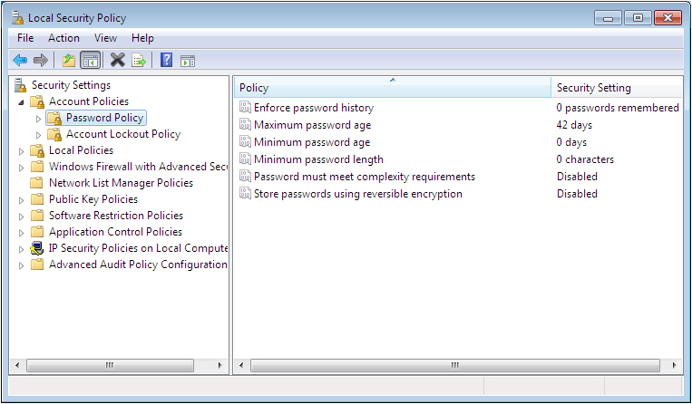
Password Policy
Notes:
Discuss the settings in the Local Security Policy, Password Policy. Mention that in order to set this policy in an AD DS you would use Group Policy Management Editor.

Slide 6
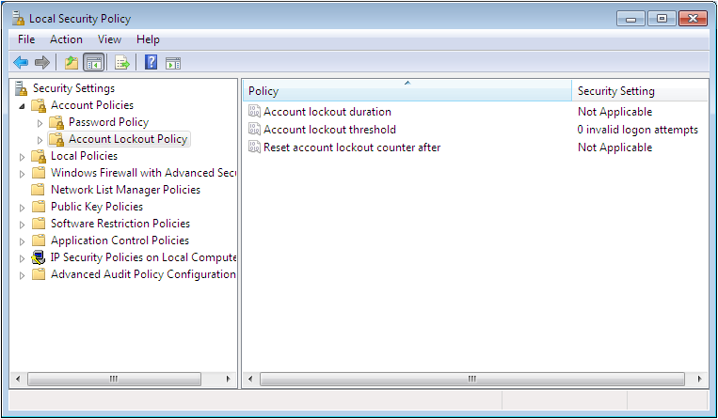
Account Lockout Policies
Notes:
Explain the concept of Account Lockout and explain the 3 settings in the Local Security Policy.

Slide 7
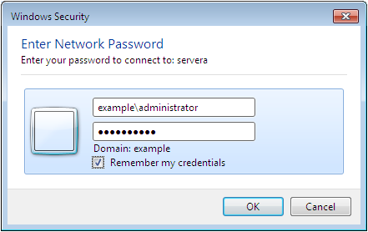
Using Credential Manager
Stores usernames and passwords for servers and Web sites in Windows Vault
Remember my credentials checkbox adds credentials to the Windows Vault
Notes:
Explain the purpose of the Credential Manager. Shown on next slide.

Slide 8
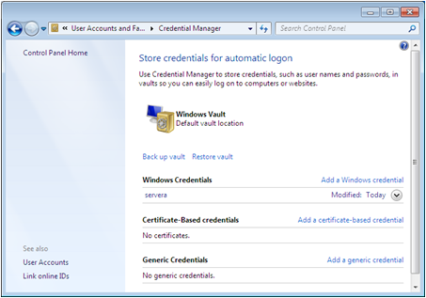
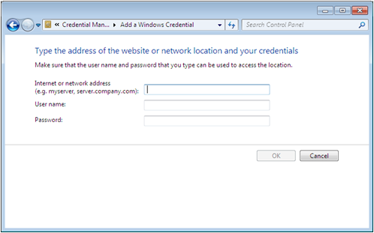
Using Credential Manager
Credentials can be added directly

Slide 9
Smart Cards
High security alternative to passwords
Requires the use of a credit card-like device
Support for Smart Cards built into Windows 7
Group Policy controls how authentication with Smart Cards is enforced
Notes:
Discuss the use of Smart Cards and why it is a more secure way of authentication than passwords.

Slide 10
Managing Certificates
Used for a variety of authentication tasks, internally, on the local network, and on the Internet.
Windows 7 maintains a certificate store for each user – Automated
Users can manage their certificate stores directly using Certificates snap-in
Notes:
Discuss the use of certificates for authentication. Mention how Windows 7 generates its own certificates for use with EFS.

Slide 11
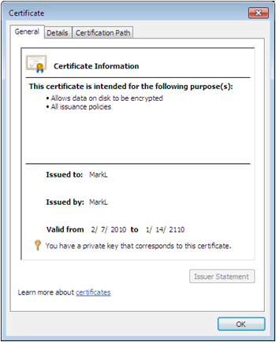
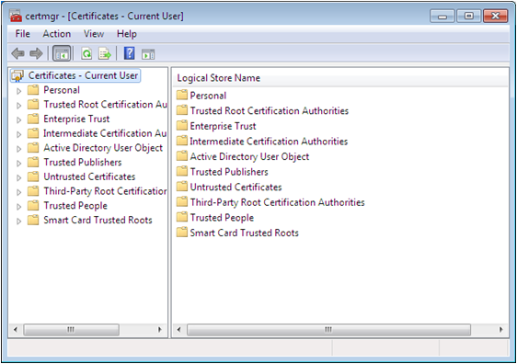
Certificates Snap-In
Certmgr.msc
Notes:
Mention the ability to view the contents of a certificate and that you can backup the certificate to a file.

Slide 12
Using Biometrics
Scans a physical characteristic of a user to confirm identity
Windows Biometric Framework provides core biometric functionality and a Biometric Device control panel
Notes:
Explain Biometrics and the different characteristics commonly used for authentication. Prior to Windows 7, this was an entirely third party solution, but now we have the Windows Biometric Framework.

Slide 13
Elevating Privileges
Use Run As Administrator context menu option
Use command line runas.exe command:
runas /user:example\administrator “notepad.exe\script.vbs”
Notes:
Explain that elevating privileges using a Run As command is the preferred method for running administrative tasks.

Slide 14
Troubleshooting Authentication Issues
Password loss is the most common problem.
There is no way for an administrator to read a password.
Passwords must be reset.
Users can change their own password if they know their old password.
Administrator can reset password without supplying old password.
Password reset Disk is better option.
Notes:
Note that it is a good idea to create a Password Reset Disk to reset you lost password. It can be created on a floppy disk or USB flash drive. Allows you to retain all EFS-encrypted files, all certificates in the user’s store, and all passwords stored in the Password Vault. These are lost if the administrator has to reset the password.

Slide 15
Authorizing Users
Authorization grants the user access to certain resources:
  Using permissions
  Configuring user rights
Notes:
Explain the difference between Permissions and User Rights.

Slide 16
Defending Against Malware
Malware: Malicious software created specifically for the purpose of infiltrating or damaging a computer system without the user’s knowledge or consent
Viruses
Trojan horses
Worms
Spyware
Adware
Notes:
Discuss malware and the different types of malware. Explain how security is one of Windows 7’s primary goals.

Slide 17
Computer Virus
Computer program designed to copy itself into other programs, with the intention of causing mischief or damage
A virus is loaded into a computer's memory and instructs its host program to copy the viral code into any number of other programs and files stored in the computer.
When the program is started or the file is accessed a fatal error occurs usually causing the program to shut down or in rare cases the computer to crash.

Slide 18
Worms
A computer worm is a type of virus that replicates itself, but does not alter any files on your machine.
Worms cause havoc by multiplying so many times that they take up all your computer's available memory or hard disk space.
This can lead to denial of service.

Slide 19
Trojan horses
A Trojan horses is a software programs that masquerade as a regular program, such as games, disk utilities, and even antivirus programs.
A Trojan horse might appear to be a computer game, but once you double-click it, the program starts writing over certain parts of your hard drive, corrupting your data.

Slide 20
Spyware
As the name implies, this is software that "spies" on your computer
Spyware can capture information like Web browsing habits, e-mail messages, usernames and passwords, and credit card information.
If left unchecked, the software can transmit this data to another person's computer over the Internet.

Slide 21
Addware
Common adware programs are toolbars that sit on your desktop or work in conjunction with your Web browser.
Adware can also be more advanced programs such as games or utilities.
Some can serve as spyware, gathering information about you from your hard drive the Web sites you visit, or your keystrokes
Spyware programs can then send the information over the Internet to another computer

Slide 22
Security in Windows 7
Lesson 7, “Working with Applications,” you learn about the security features included in Internet Explorer 8.
Lesson 9, “Working with Workgroups and Domains,” you learn how User Account Control helps to prevent malware from obtaining administrative privileges.
Lesson 12, “Working with Mobile Computers,” you learn about the security features specifically designed for use on mobile and wireless computers.

Slide 23
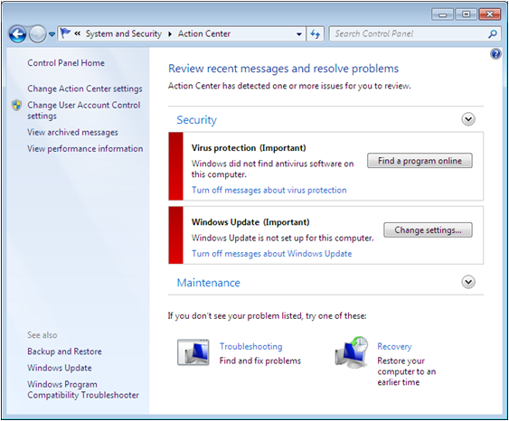
Introducing Windows 7 Action Center
Notes:
Introduce the Action Center and liken it to the Vista Security Center and explain that it starts and runs automatically, to provide automatic notifications to alert the user of security vulnerabilities. Describe the two main sections: Security and Maintenance. Refer to the task list on the left side of the screen and note that you can control which message appear in the Action Center interface by using the Change Action Center settings.

Slide 24
Introducing Windows Firewall
A firewall is a software program that protects a computer by allowing certain types of network traffic in and out of the system while blocking others.
Notes:
Describe the purpose of a Firewall.

Slide 25
Understanding Firewalls
Base their filtering on TCP/IP characteristics:
  IP address - Specific computers
  Protocol numbers - Transport layer protocol
  Port number - Application running on computer
Rules are used to filter traffic two ways:
  Admit all traffic, except that which applies to the rules
  Block all traffic, except that which applies to the rules
Notes:
Explain the firewall filtering procedure.

Slide 26
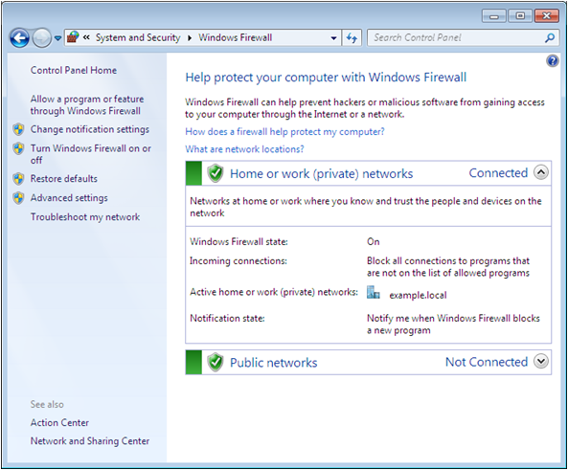
The Windows Firewall Window
Notes:
Explain that there are different expandable headings for the different network locations: home or work, public and domain (if connected to an AD DS). Explain the information under each heading.

Slide 27
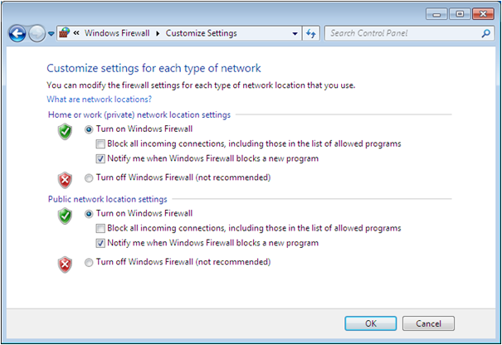
Using the Windows Firewall Control Panel
Notes:
Describe the settings that can be changed with the Windows Firewall Control Panel.

Slide 28
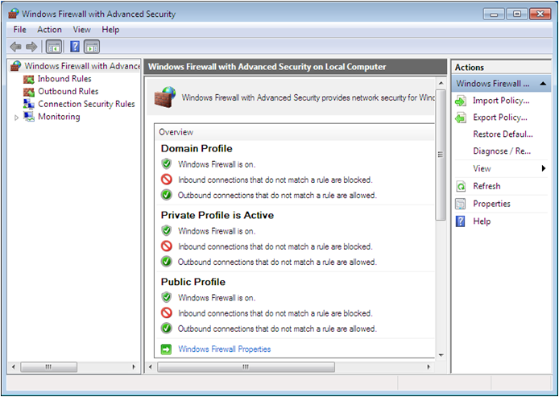
Using the Windows Firewall with Advanced Security Console
Notes:
This tool provides direct access to the rules that control the behavior of the Windows Firewall. Separate profiles are maintained for each network location, domain, public and private.

Slide 29
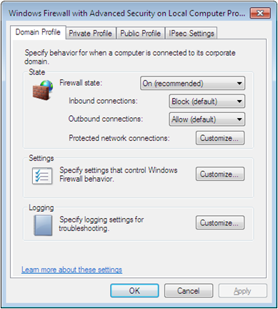
Using the Windows Firewall with Advanced Security Console
Default profile settings can be modified
Inbound and outbound rules can be created
Notes:
Explain some of the settings that can be configured with this tool.

Slide 30
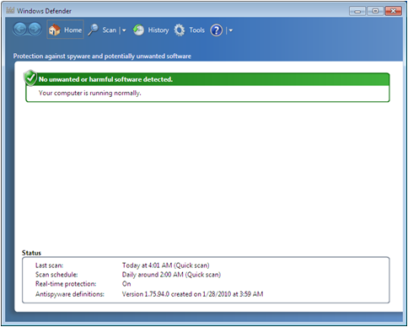
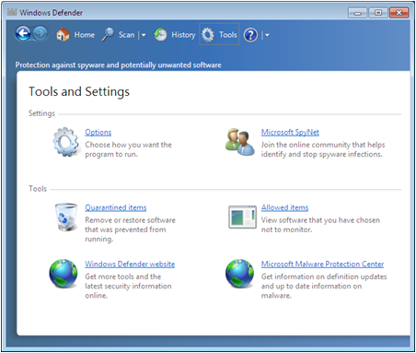
Introducing Windows Defender
Notes:
Explain the purpose of Windows Defender and describe some of the tools and settings available. Make sure to note that Windows Defender is not a full-featured antivirus program.

Slide 31
Malicious Software Removal Tool
A single user virus scanner supplied with monthly updates
Removes any potentially damaging software it finds
There are no controls and is not permanently installed
Should install a full-featured antivirus program on Windows 7
Notes:
Explain the Malicious Software Removal Tool.

Slide 32
Using the Encrypting File System (EFS)
EFS is a feature of NTFS that encodes the files on a computer.
The system is keyed to a specific user account.
Uses public and private keys (PKI).
The user who creates the file is the only person who can read it.
Notes:
Explain how EFS works and that it is only available on Professional, Enterprise and Ultimate editions of Windows 7. Compressed files cannot be encrypted.

Slide 33
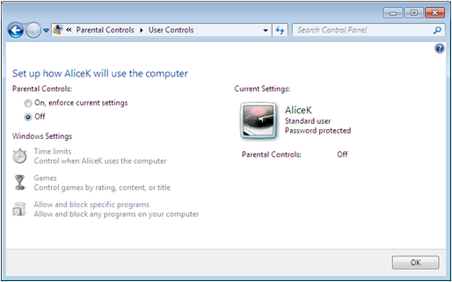
Configuring Parental Controls
Parental controls enables parents to limit their children’s access to specific Internet sites, games, and applications.
Notes:
Describe the purpose of Parental Controls

Slide 34
Setting Up Parental Controls
Based on user accounts – Every family member must have their own account
Impose restrictions on accounts
  Filter Web sites users are allowed to access
  Limit downloads from Internet sites
  Enforce time limits for computer use
  Restrict access to games by rating, content, or title
  Allow or block specific applications
Notes:
Describe what you must do to set up Parental Controls and what type of access you can control.

Slide 35
Skills Summary
Password Policies enforce password security practices.
Credential Manager is a tool that stores the user names and passwords people supply to servers and Web sites in a Windows Vault.
Permissions and user rights are used to authorize users’ access to resources and tasks.
Action Center is a centralized console that enables users and administrators to access, monitor, and configure the various Windows 7 security mechanisms.
Notes:
Review the Skill Summary to wrap up your lesson.

Slide 36
Skills Summary (cont.)
Windows Firewall is a software program that protects a computer by allowing certain types of network traffic in and out of the system while blocking others.
Windows Defender helps to defend against spyware.
The Malicious Software Removal Tool is a single user virus scanner.
The Encrypting File System (EFS) is a feature of NTFS that encodes the files on a computer.

